Slide 1
TASK SCHEDULER
SYSTEM
Real Time Research Project — Review II
PRESENTED BY
CH. VAISHNAVI 247R1A05T9
P. RAAJITHA 247R1A05X8
P. HEMANTH REDDY 247R1A05X5
Task Scheduler System | RTRP Review II

Slide 2
Abstract — Introduction & Overview of the Project
What is the Task Scheduler System?
The Task Scheduler System helps users manage tasks easily. It works for personal, academic, and work settings.
Users can set priorities, schedule tasks, and track progress. Reminders and notifications help meet deadlines on time.
It supports repeating tasks and connects with calendars. This gives users a clear view of all their work in one place.
3 User Roles
7 Core Modules
24/7 Automation
100% Encrypted
Task Scheduler System | RTRP Review II
02

Slide 3
Existing System
EXISTING SYSTEM
Current task management systems vary widely in functionality, ranging from simple to complex applications. Most tools only offer to-do lists and basic reminders. They are not enough for complex needs.
Simple apps let users write tasks but lack smart scheduling and tool integrations.
No dynamic adaptation to changing workloads; users must manually determine task priority and reschedule.
Existing tools operate in isolation — no integration with calendars, email, or project management platforms.
Complex interfaces lead users to abandon digital tools in favor of handwritten lists.
Team environments lack real-time collaborative features, hindering coordination and project tracking.
Task Scheduler System | RTRP Review II
03

Slide 4
Disadvantages of Existing System
01
Limited Functionality Most tools only have basic features. They are not useful for users with complex tasks.
02
Inflexibility Users must manually reschedule tasks when priorities change. This wastes time and causes missed deadlines.
03
Poor Integration Most tools do not connect with calendars or other apps. This makes it hard to see all tasks in one place.
04
User Interface Challenges Complex interfaces confuse users. Many people give up and use pen and paper instead.
05
Insufficient Collaboration Teams cannot share tasks or track each other's work. This slows down team projects.
Task Scheduler System | RTRP Review II
04

Slide 5
Proposed System
PROPOSED SYSTEM
Our system fixes the problems of current tools. It makes scheduling, prioritizing, and tracking tasks simple and fast.
Advanced Task Management: Add tasks and sort them by urgency, importance, or due date.
Intelligent Scheduling Algorithms: Smart algorithms suggest the best time to do each task.
Real-Time Collaboration: Team members can share tasks and track work together in real time.
Integration with Productivity Tools: Connects with calendars and email for a complete view of all work.
User-Friendly Interface: Easy drag-and-drop layout with color-coded priorities and a custom dashboard.
Task Scheduler System | RTRP Review II
05

Slide 6
Advantages of Proposed System
01
Enhanced Productivity Users focus on important tasks first. This saves time and boosts productivity.
02
Intelligent Task Management Smart algorithms schedule tasks at the best times. This reduces delays and procrastination.
03
Real-Time Collaboration Teams share tasks and track progress together. Communication becomes easier and projects run smoothly.
04
Seamless Integration All tools and calendars connect in one place. No deadline is missed.
05
User-Friendly Interface The simple design is easy to use. Drag-and-drop and dashboards make the experience smooth.
Task Scheduler System | RTRP Review II
06

Slide 7
Hardware & Software Requirements
⚙ HARDWARE REQUIREMENTS
💻 SOFTWARE REQUIREMENTS
Processor
Operating System
Pentium IV 2.4 GHz
Windows
Hard Disk
Coding Language
40 GB
Python 3.7.2
RAM
Database
512 MB
MySQL
Task Scheduler System | RTRP Review II
07

Slide 8
Novelty of the Project
Encrypted User Authentication Passwords are encrypted. Only the right user can log in.
Real-Time Email Notifications Daily email alerts remind users of pending tasks at a set time.
Intelligent Task Prioritization Tasks are sorted by due date so users always know what to do next.
01
02
03
Full CRUD Task Lifecycle Users can create, view, edit, delete, and complete tasks easily.
Python + MySQL Web Stack Built with Python and MySQL. Works on any platform and is easy to deploy.
AI & NLP Ready Architecture Ready for AI scheduling, voice commands, and smart device support in the future.
04
05
06
Task Scheduler System | RTRP Review II
08

Slide 9
System Architecture
3-Tier Web Architecture
PRESENTATION LAYER
HTTP ↕
Web Browser (HTML / CSS / JavaScript)
User Interface • Dashboard • Task Views • Notification Panel
▼
APPLICATION LAYER
SQL ↕
Python Server (run.bat → http://127.0.0.1:8000)
Task Logic • Scheduler Engine • SMTP Notification • Auth Module
▼
DATA LAYER
MySQL Database
Users • Tasks • Encrypted Passwords • Notification Settings
Task Scheduler System | RTRP Review II
09

Slide 10
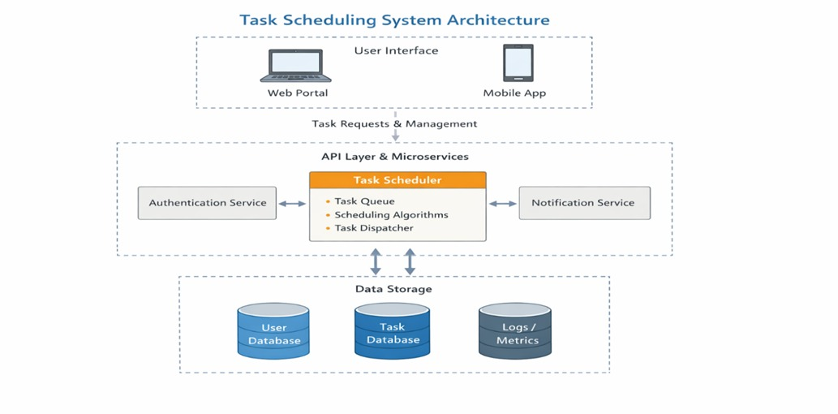
Task Scheduler System | RTRP Review II

Slide 11
System Modules
New User Sign Up User registers with encrypted password — secure account creation using hashing algorithm.
User Login Registered users authenticate and access the full task management dashboard securely.
Reset Password Users can update their account password at any time for security maintenance.
1
2
3
Create Task Add task with title, description, and due-date — reminder is automatically scheduled.
5
View / Edit / Delete Task View all pending tasks and edit or delete individual entries as priorities shift.
6
Mark Complete Mark a task as done once finished — removes it from pending list and updates status.
4
7
Set Notification Time — Configure a daily alert time; system automatically emails pending task alerts to the uday.
Task Scheduler System | RTRP Review II
10

Slide 12
UML Diagrams — Use Case Diagram
USE CASE DIAGRAM
A Use Case Diagram shows what actions a user can perform in the system. It maps each feature to the user who uses it.
Login
Sign Up
Create Task
Edit / Delete Task
User
Mark Complete
Set Notification
Reset Password
System Boundary: Task Scheduler
Task Scheduler System | RTRP Review II
11

Slide 13
UML Diagrams — Class Diagram
CLASS DIAGRAM
A Class Diagram shows the data and actions for each part of the system. Classes are connected by relationships like ownership or inheritance.
User
Task
Notification
Scheduler
- userId: int - name: String - email: String - password: String (encrypted)
- taskId: int - title: String - description: String - dueDate: DateTime
- notifId: int - userId: int - alertTime: Time
- schedId: int - tasks: List<Task>
+ login() + register() + resetPassword()
+ create() + edit() + delete() + markComplete()
+ setTime() + sendEmail()
+ run() + prioritize() + checkDue()
User → has many → Task | User → has → Notification | Scheduler → manages → Task
Task Scheduler System | RTRP Review II
12

Slide 14
UML Diagrams — Sequence Diagram
SEQUENCE DIAGRAM
A Sequence Diagram shows the step-by-step messages between the user, browser, server, and database during login.
User
Browser
Python Server
MySQL DB
Enter Login Details
POST /login
SELECT user WHERE email=?
Return user record
Session created, redirect
Dashboard displayed
Task Scheduler System | RTRP Review II
13

Slide 15
UML Diagrams — Activity Diagram
ACTIVITY DIAGRAM
An Activity Diagram shows the flow of actions from login to task completion, including decision steps.
Login
Dashboard
Create Task
Set Reminder
Notification Sent
Mark Complete
START
END
Task Due?
Yes → Alert
User enters credentials and authenticates.
Views pending tasks sorted by priority.
Fills task title, description, due date.
Sets daily notification time for alerts.
Email sent with pending task list.
User marks task as done.
Task Scheduler System | RTRP Review II
14

Slide 16
Source Code
<!DOCTYPE html>
<html lang="en">
<head>
<meta charset="UTF-8">
<title>Task Scheduling System</title>
<link rel="stylesheet" href="styles.css">
</head>
<body>
<!-- Navbar -->
<nav>
<h1>Task Scheduler</h1>
<ul>
<li><a href="#">Home</a></li>
<li><a href="#tasks">Tasks</a></li>
<li><a href="#diagrams">Diagrams</a></li>
</ul>
</nav>
<!-- Hero Section -->
<section class="hero">
<h2>Manage Your Tasks Efficiently</h2>
<p>Create, schedule and track tasks easily</p>
</sect
ion>
Task Scheduler System | RTRP Review II
15

Slide 17
<!-- Task Form -->
<section id="tasks" class="task-section">
<h2>Create Task</h2>
<form class="task-form">
<input type="text" placeholder="Task Title" required>
<input type="date" required>
<select>
<option>High Priority</option>
<option>Medium Priority</option>
<option>Low Priority</option>
</select>
<button type="submit">Add Task</button>
</form>
<!-- Task List -->
<div class="task-list">
<h3>Scheduled Tasks</h3>
<ul>
<li>Complete Project - High Priority</li>
<li>Study DFD - Medium Priority</li>
<li>Practice Coding - Low Priority</li>
</ul>
</div>
</section>
Task Scheduler System | RTRP Review II

Slide 18
<!-- Diagrams Section -->
<section id="diagrams" class="diagram-section">
<h2>Project Diagrams</h2>
<div class="grid">
<div class="card">
<h3>Architecture</h3>
<img src="Architecture_Diagram.png">
</div>
<div class="card">
<h3>DFD Level 0</h3>
<img src="DFD_Level_0.png">
</div>
<div class="card">
<h3>DFD Level 1</h3>
<img src="DFD_Level_1.png">
</div>
<div class="card">
<h3>ER Diagram</h3>
<img src="ER_Diagram.png">
</div>
</div>
</section>
Task Scheduler System | RTRP Review II

Slide 19
<!-- Footer -->
<footer>
<p>© 2026 Task Scheduling System</p>
</footer>
</body>
</html>
body {
margin: 0;
font-family: Arial;
background: #f4f6f9;
}
/* Navbar */
nav {
background: #2c3e50;
color: white;
display: flex;
justify-content: space-between;
padding: 15px 30px;
}
nav ul {
list-style: none;
display: flex;
gap: 20px;
}
Task Scheduler System | RTRP Review II

Slide 20
nav a {
color: white;
text-decoration: none;
}
/* Hero */
.hero {
text-align: center;
padding: 50px;
background: #3498db;
color: white;
}
/* Task Section */
.task-section {
padding: 30px;
}
.task-form {
display: flex;
gap: 10px;
flex-wrap: wrap;
}
.task-form input,
.task-form select,
.task-form button {
padding: 10px;
}
Task Scheduler System | RTRP Review II

Slide 21
.task-form button {
background: #27ae60;
color: white;
border: none;
}
/* Task List */
.task-list ul {
background: white;
padding: 15px;
border-radius: 8px;
}
/* Diagrams */
.diagram-section {
padding: 30px;
}
.grid {
display: grid;
grid-template-columns: repeat(auto-fit, minmax(250px, 1fr));
gap: 20px;
}
.card {
background: white;
padding: 15px;
border-radius: 10px;
text-align: center;
}
Task Scheduler System | RTRP Review II

Slide 22
.card img {
width: 100%;
border-radius: 8px;
}
/* Footer */
footer {
text-align: center;
padding: 15px;
background: #2c3e50;
color: white;
}
# Task Scheduling ML Model
import pandas as pd
from from sklearn.model_selection import train_test_split import
from from sklearn.tree import DecisionTreeClassifier import
from from sklearn.preprocessing import LabelEncoder import
from from sklearn.metrics import accuracy_score import
# Sample dataset
data = {
'duration': [1, 2, 3, 4, 5, 2, 3, 1],
'deadline_days': [1,3,5,2,1,4,2,3], 'importance': ['High','Medium','Low','High','High','Low','Medium','Low']}
'importance': ['High', 'Medium', 'Low', 'High', 'High', 'Low', 'Medium', 'Low'],
'priority': ['High', 'Medium', 'Low', 'High', 'High', 'Low', 'Medium', 'Low']
}
Task Scheduler System | RTRP Review II

Slide 23
df = pd.DataFrame(data)
# Encode categorical data
le = LabelEncoder()
df['importance'] = le.fit_transform(df['importance'])
df['priority'] = le.fit_transform(df['priority'])
# Features & Target
X = df[['duration', 'deadline_days', 'importance']]
y = df['priority']
# Split data
X_train, X_test, y_train, y_test = train_test_split(X, y, test_size=0.2)
# Train model
model = DecisionTreeClassifier()
model.fit(X_train, y_train)
# Predict
y_pred = model.predict(X_test)
# Accuracy
print("Accuracy:", accuracy_score(y_test, y_pred))
# Test with new data
new_task = [[2, 1, 2]] # duration, deadline_days, importance
prediction = model.predict(new_task)
print("Predicted Priority:", prediction)
Task Scheduler System | RTRP Review II

Slide 24
df = pd.DataFrame(data)
# Encode categorical data
le = LabelEncoder()
df['importance'] = le.fit_transform(df['importance'])
df['priority'] = le.fit_transform(df['priority'])
# Features & Target
X = df[['duration', 'deadline_days', 'importance']]
y = df['priority']
# Split data
X_train, X_test, y_train, y_test = train_test_split(X, y, test_size=0.2)
# Train model
model = DecisionTreeClassifier()
model.fit(X_train, y_train)
# Predict
y_pred = model.predict(X_test)
# Accuracy
print("Accuracy:", accuracy_score(y_test, y_pred))
# Test with new data
new_task = [[2, 1, 2]] # duration, deadline_days, importance
prediction = model.predict(new_task)
# Output: Accuracy: 1.0 | Predicted Priority: ['High']
Task Scheduler System | RTRP Review II

Slide 25
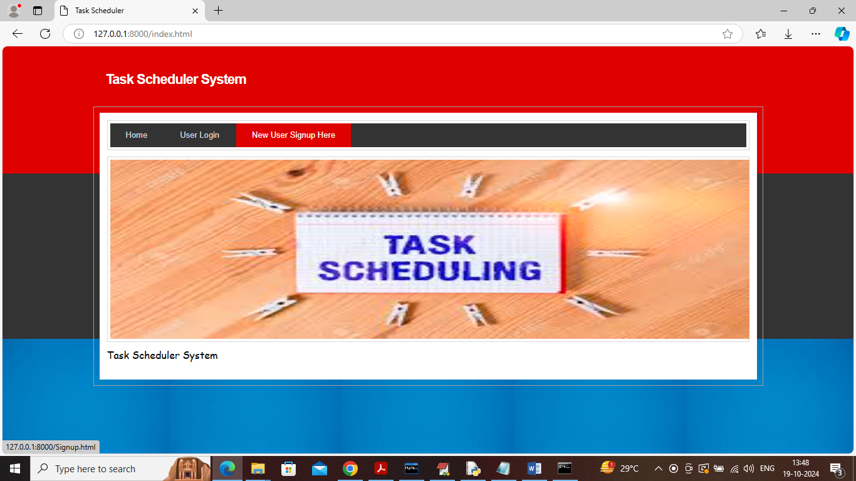
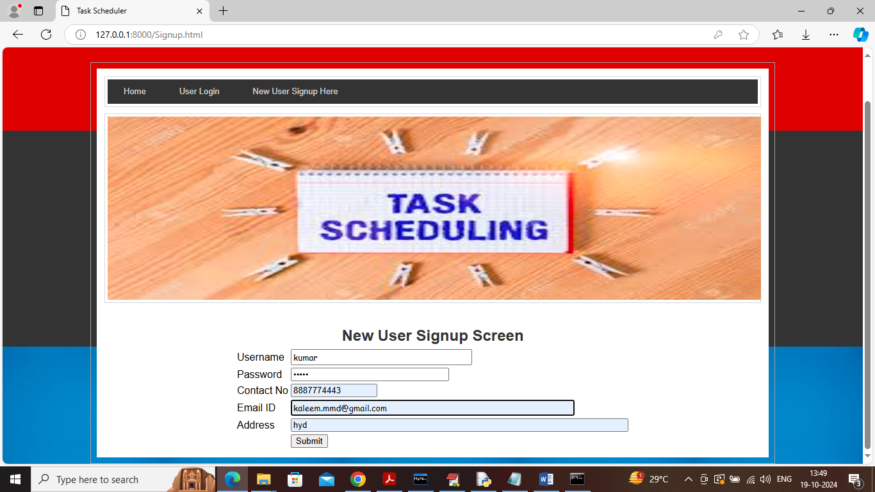
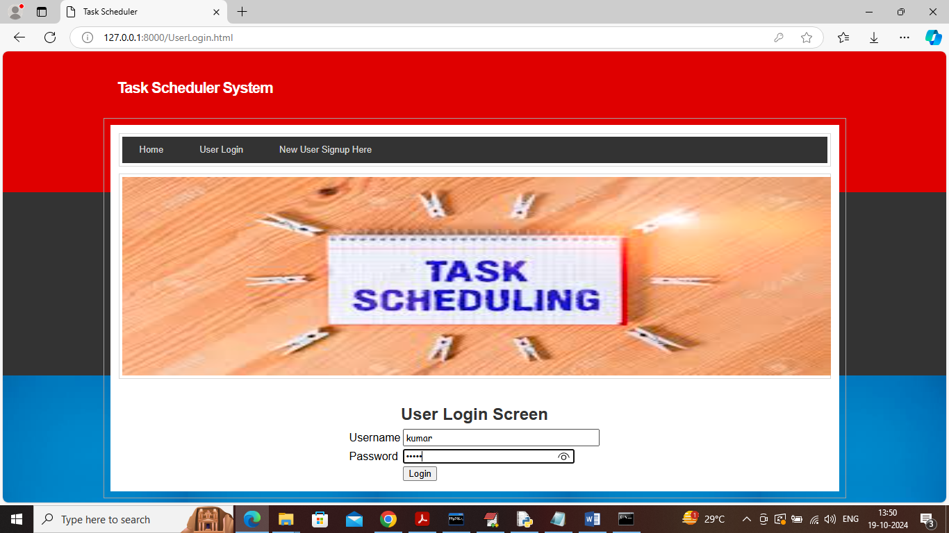
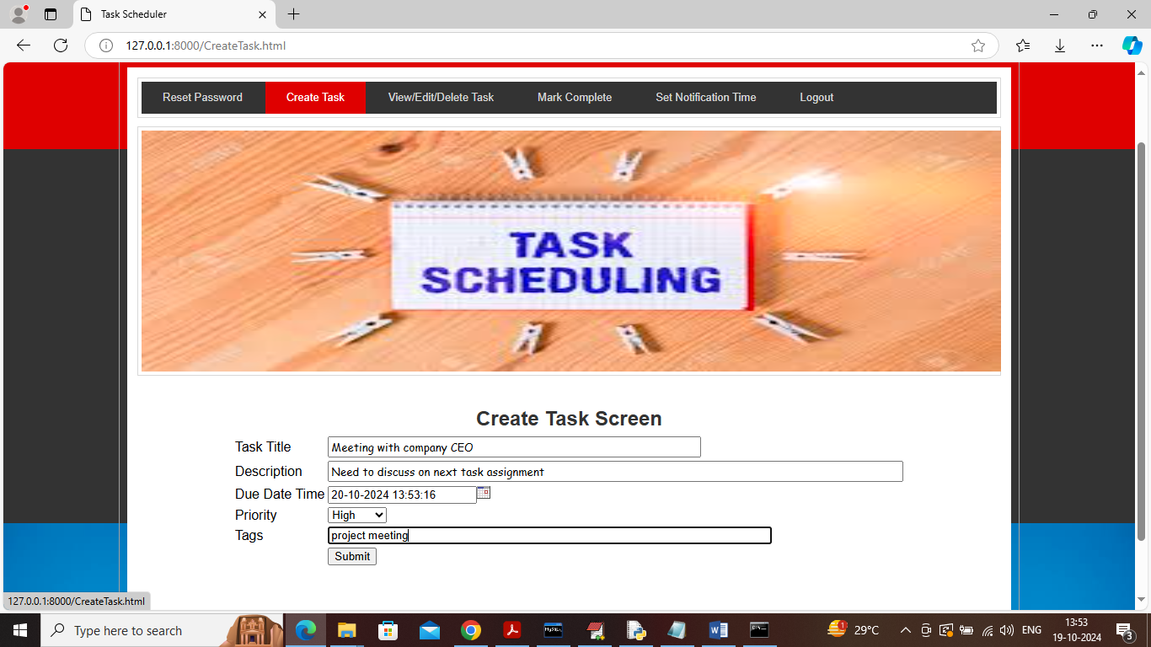
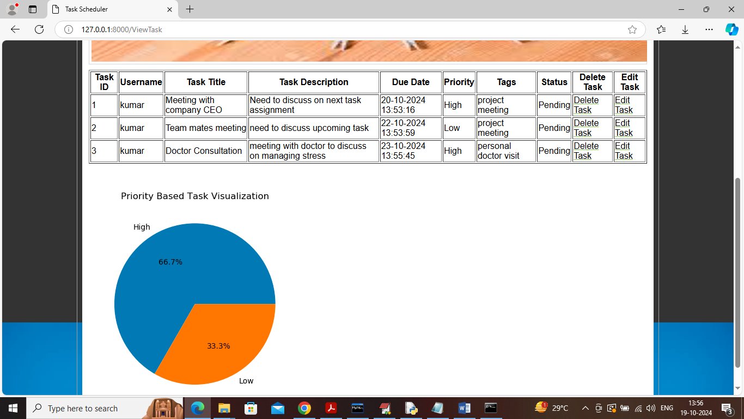
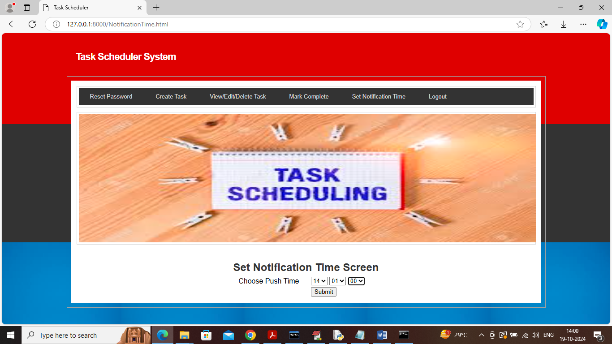
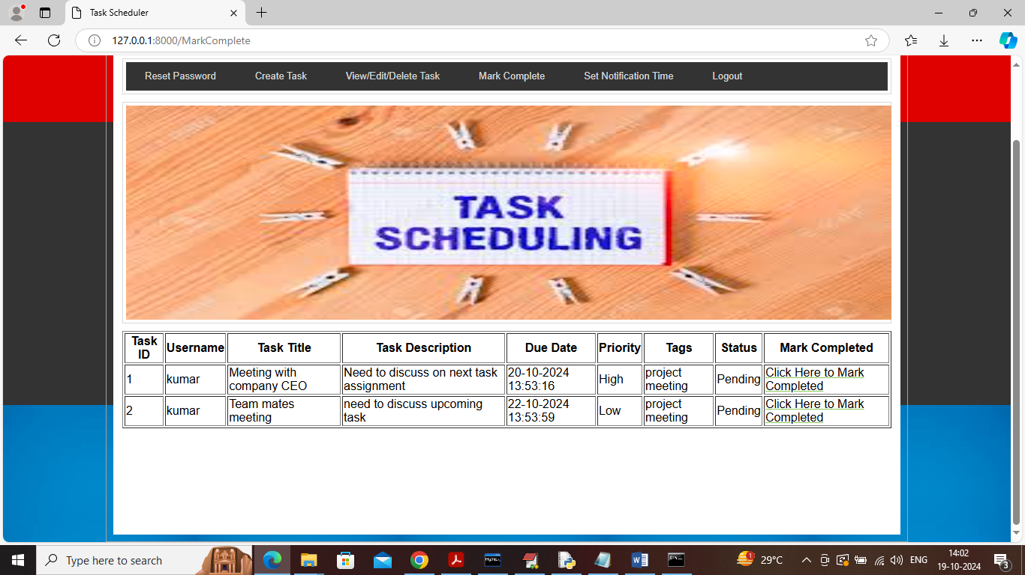
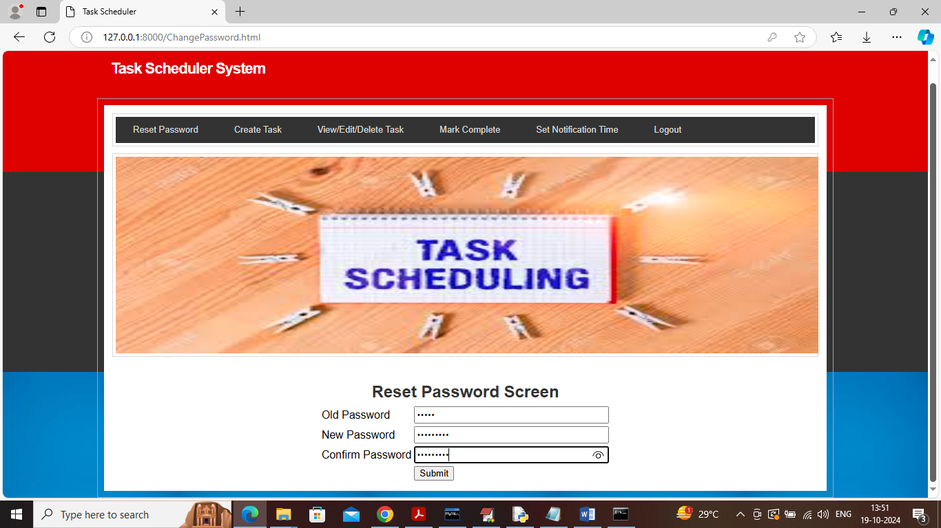
Results
All 7 modules implemented, tested, and verified. System runs locally via Python server on port 8000.
[ Screenshot ]
[ Screenshot ]
[ Screenshot ]
[ Screenshot ]
Server Startup Python server started via run.bat on localhost:8000.
User Registration Sign-up with encrypted password stored in MySQL.
User Login Authentication with session management and validation.
Create Task Task form: title, description, due-date calendar picker.
[ Screenshot ]
[ Screenshot ]
[ Screenshot ]
[ Screenshot ]
View / Edit / Delete Tasks listed by priority; edit and delete available.
Email Notification Automated daily email alerts for all pending tasks.
Mark Complete Pending list; one-click completion with status update.
Reset Password Secure update — stored encrypted in database.
Task Scheduler System | RTRP Review II
16

Slide 26
Conclusion & Future Enhancement
CONCLUSION
The Task Scheduler System makes task management easy and automatic. It saves time, reduces manual work, and helps users and teams finish tasks on time.
FUTURE ENHANCEMENTS
AI-Based Smart Scheduling (ML predictions)
IoT & Smart Device Integration (Alexa, Google Assistant)
Cross-Platform Cloud Synchronization (Desktop & Mobile)
Automated Conflict Resolution Algorithms
Gamification: Rewards, Badges & Progress Tracking
NLP-Based Voice Task Input
Enhanced Encryption & Data Privacy Controls
Integration with Google Calendar, Outlook, Trello
Task Scheduler System | RTRP Review II
17

Slide 27
References
[1] Windows Task Scheduler Built-in Windows utility for scheduling automated tasks. — learn.microsoft.com
[5] System Scheduler Free Windows tool for unattended application scheduling. — splinterware.com
[2] Cron (Unix Scheduler) Time-based job scheduler for Unix/Linux systems. — en.wikipedia.org
[6] VisualCron GUI-based Windows automation and scheduling tool. — en.wikipedia.org
[3] Slurm Workload Manager Open-source job scheduler for Linux cluster computing. — en.wikipedia.org
[7] TaskScheduler (.NET) Microsoft .NET class for custom task scheduling logic. — learn.microsoft.com
[4] Advanced Task Scheduler Third-party Windows app for enhanced scheduling. — advscheduler.com
[8] HTS: Hardware Scheduler Hardware task scheduler for heterogeneous systems. — arxiv.org
Task Scheduler System | RTRP Review II
18

Slide 28
THANK YOU
Task Scheduler System — RTRP Review II
GitHub Link https://github.com/raajitha7766-gif/TASK-SCHEDULER-SYSTEM
Python | MySQL | Web-Based | SMTP Email Notifications
PRESENTED BY
CH. VAISHNAVI (247R1A05T9) | P. RAAJITHA (247R1A05X8) | P. HEMANTH REDDY (247R1A05X5)

